Slide 1

CSS
Lesson 9

Slide 2
CSS Float
With CSS float, an element can be pushed to the left or right, allowing other elements to wrap around it.
Property | Description | Values
clear | Specifies which sides of an element where other floating elements are not allowed | left right both none inherit
float | Specifies whether or not a box should float | left right none inherit

Slide 3
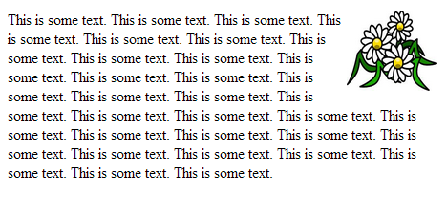

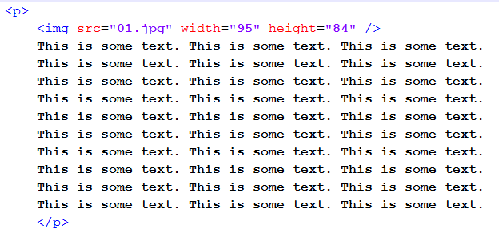
CSS Float
style.css
doc.html

Slide 4
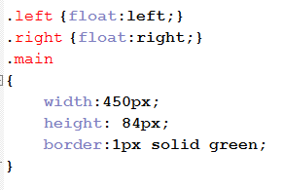

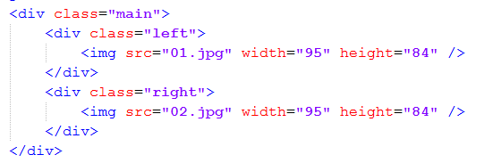
CSS Float
style.css
doc.html

Slide 5
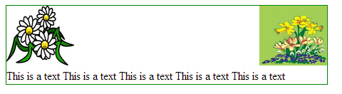
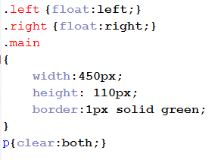
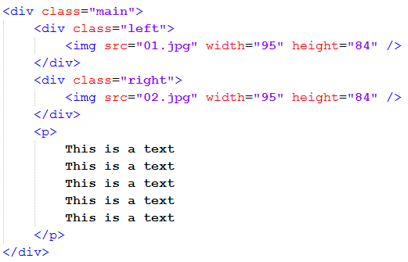
CSS Float
style.css
doc.html

Slide 6
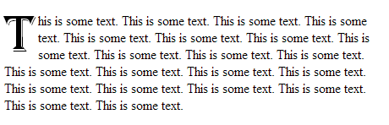
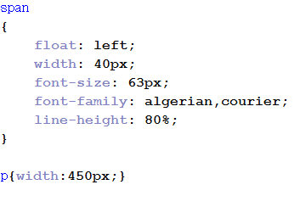
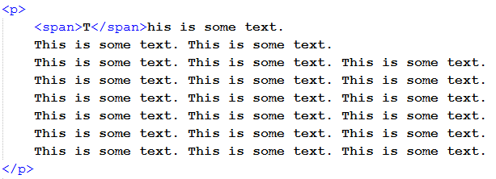
CSS Float
style.css
doc.html

Slide 7
CSS Overflow
The overflow property specifies what happens if content overflows an element's box.
Value | Description
visible | The overflow is not clipped. It renders outside the element's box. This is default
hidden | The overflow is clipped, and the rest of the content will be invisible
scroll | The overflow is clipped, but a scroll-bar is added to see the rest of the content
auto | If overflow is clipped, a scroll-bar should be added to see the rest of the content
inherit | Specifies that the value of the overflow property should be inherited from the parent element

Slide 8
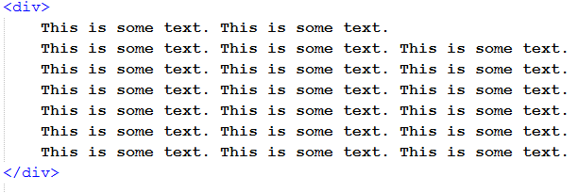
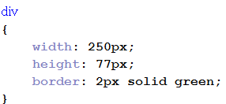
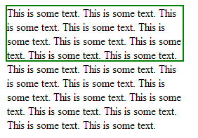
CSS Overflow
doc.html
style.css

Slide 9

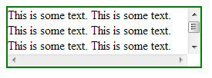

CSS Overflow

Slide 10
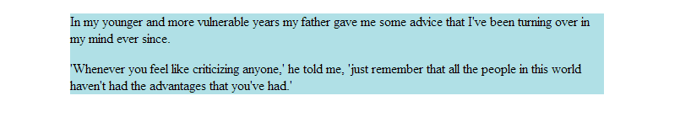
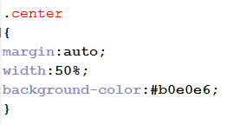
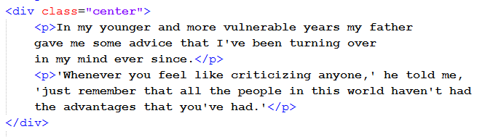
CSS Aligning
Center Aligning Using the margin Property
style.css
doc.html

Slide 11
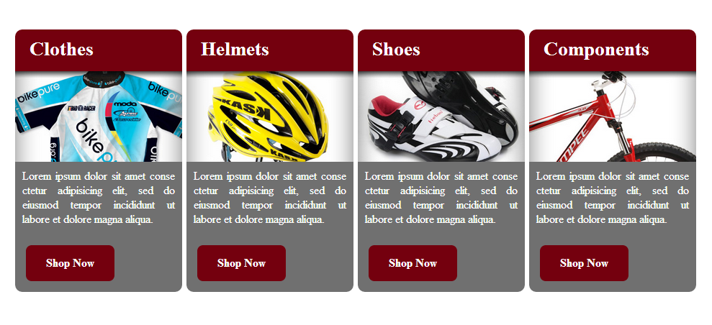
Task1:

Slide 12

Task2:

